Slide 1

Major Project-I(ID-CA301P) Odd Semester Session 2025-26
Internship Data Management System
Manish Kumar Singh (202410116100114 )
Mansi Garg (202410116100116)

Slide 2
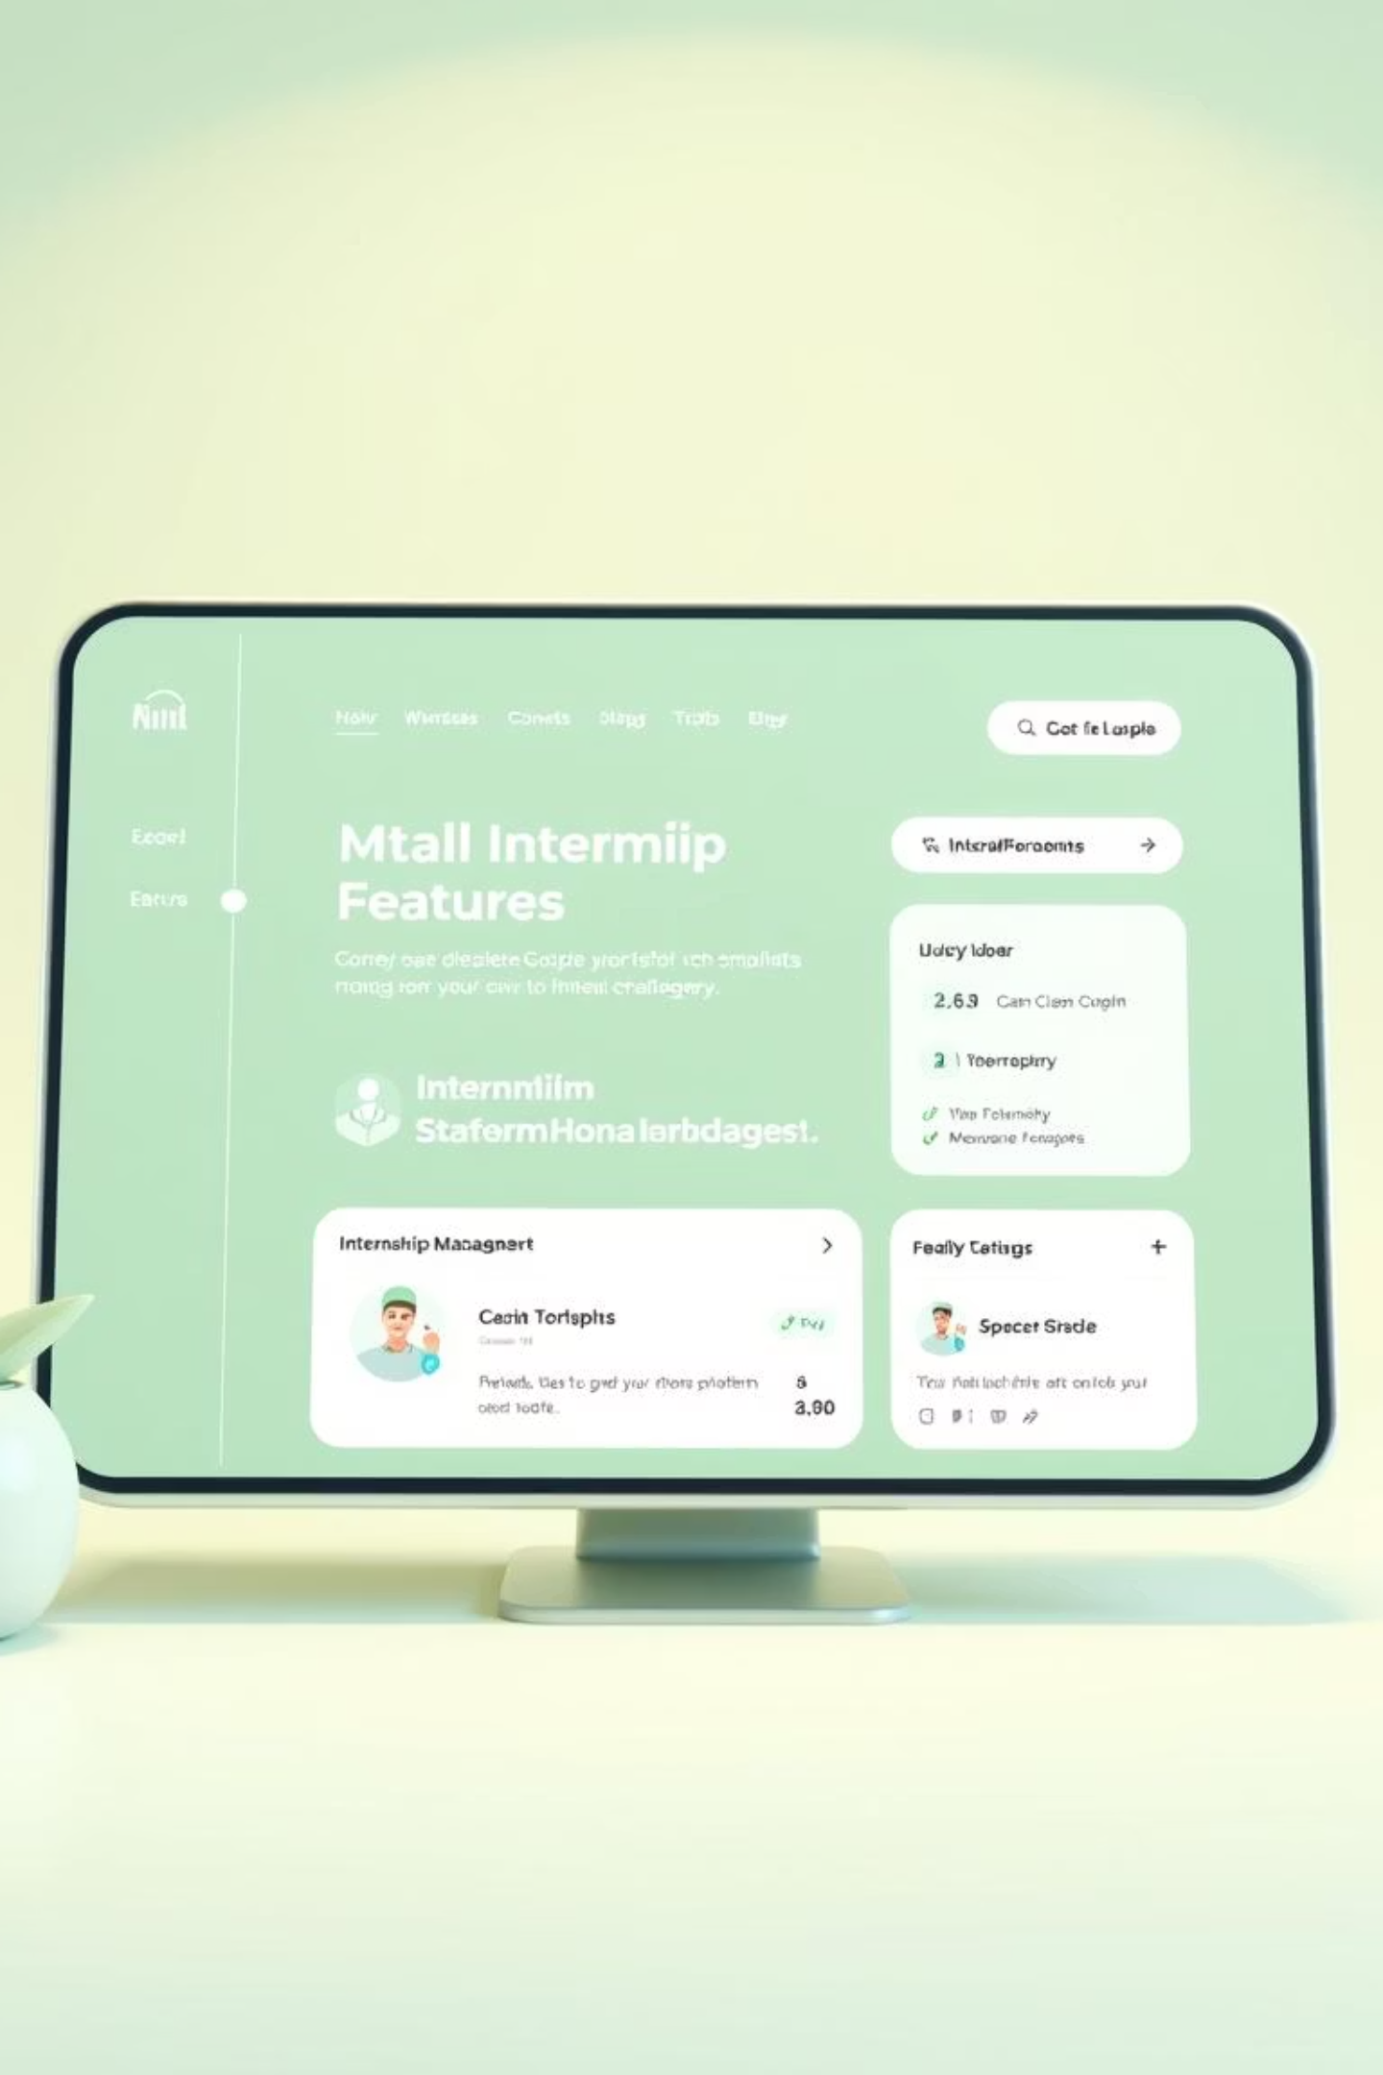
Internship Management System
Internships are important for students to gain practical knowledge.
Manual handling of interns, tasks, and certificates is time-consuming.
Communication between interns and admins becomes difficult without a system.
Our project offers a single digital platform for smooth and transparent internship management.

Slide 3
Problem Statement
Manual process is time-consuming & inefficient
Students face difficulties in applying/tracking
Companies struggle to manage records
Lack of centralized monitoring system
To create a digital platform for students, companies, and admins
Simplify internship application & tracking process
Enable students to submit details & feedback online
Provide admin with centralized monitoring & reporting

Slide 4
Key Objectives
1
2
Centralized Management
Automate Processes
To create a digital platform for students, companies, and admins
Simplify applications, evaluations, and certificate generation.
3
4
Real-time Tracking
Enhanced Feedback
Enable admins to monitor progress and assign mentors.
Provide structured feedback for continuous intern improvement.

Slide 5
Features
Intern View(Student view)
Admin View(Teacher’s View)
Secure Registration & Login.
Fill all the details of their internship .
Upload offer letter & documents.
Receive feedback & performance reports.
Upload certificate after completion.
Post company reviews.
Secure Admin Login..
View applications by course & year.
Review submissions & provide feedback.
Download students offer letters and certificates.
Moderate company reviews.
Export student performance reports

Slide 6

SDG LEVEL
SDG 9 – Industry, Innovation and Infrastructure 🏗️
Manages internships through a digital platform.
Strengthens collaboration between industry and academia.
Creates an innovative internship matching system.

Slide 7




Admin Control
Admin Creation
Candidate Review
Login and Register .
Quickly select or reject applicants.
Progress Monitoring
Evaluation & Certificates
Track submissions, timesheets, and reports.
Provide feedback, evaluate performance, and issue certificates.

Slide 8
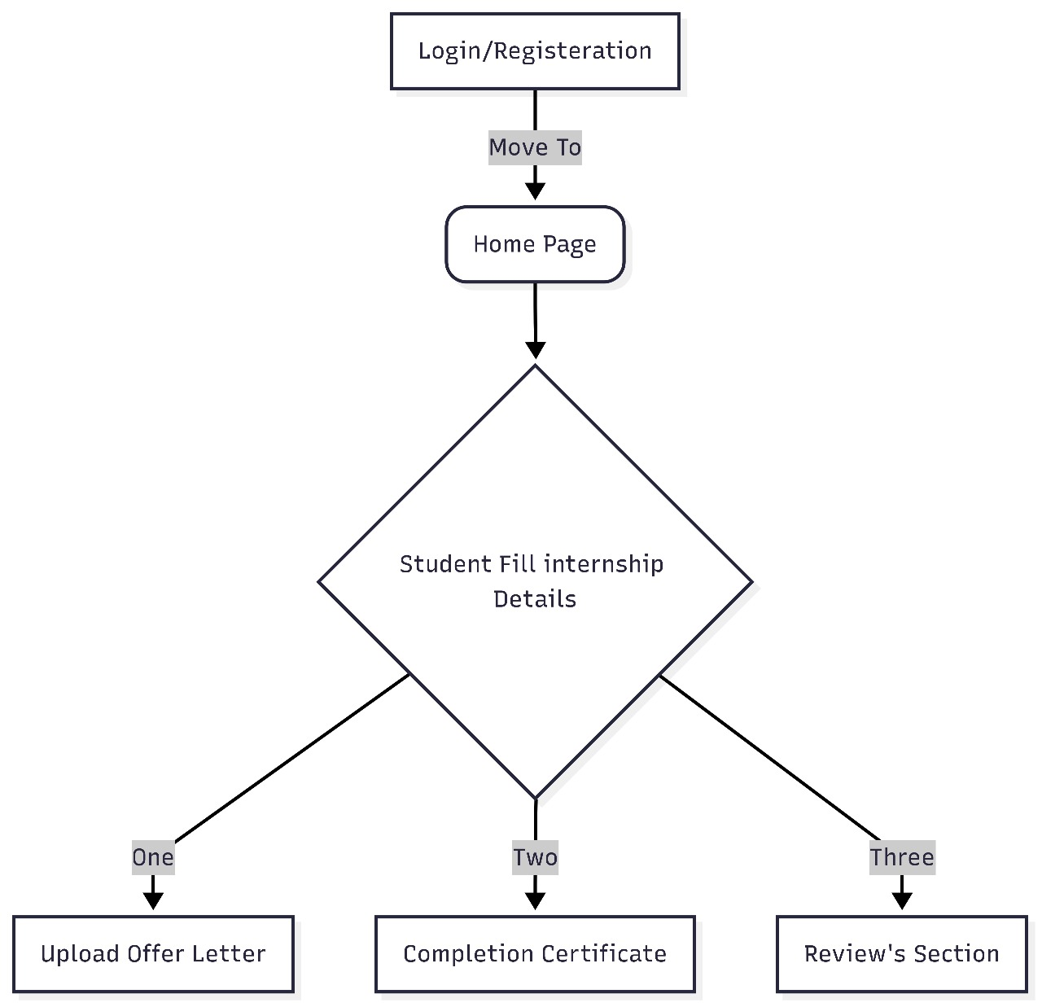
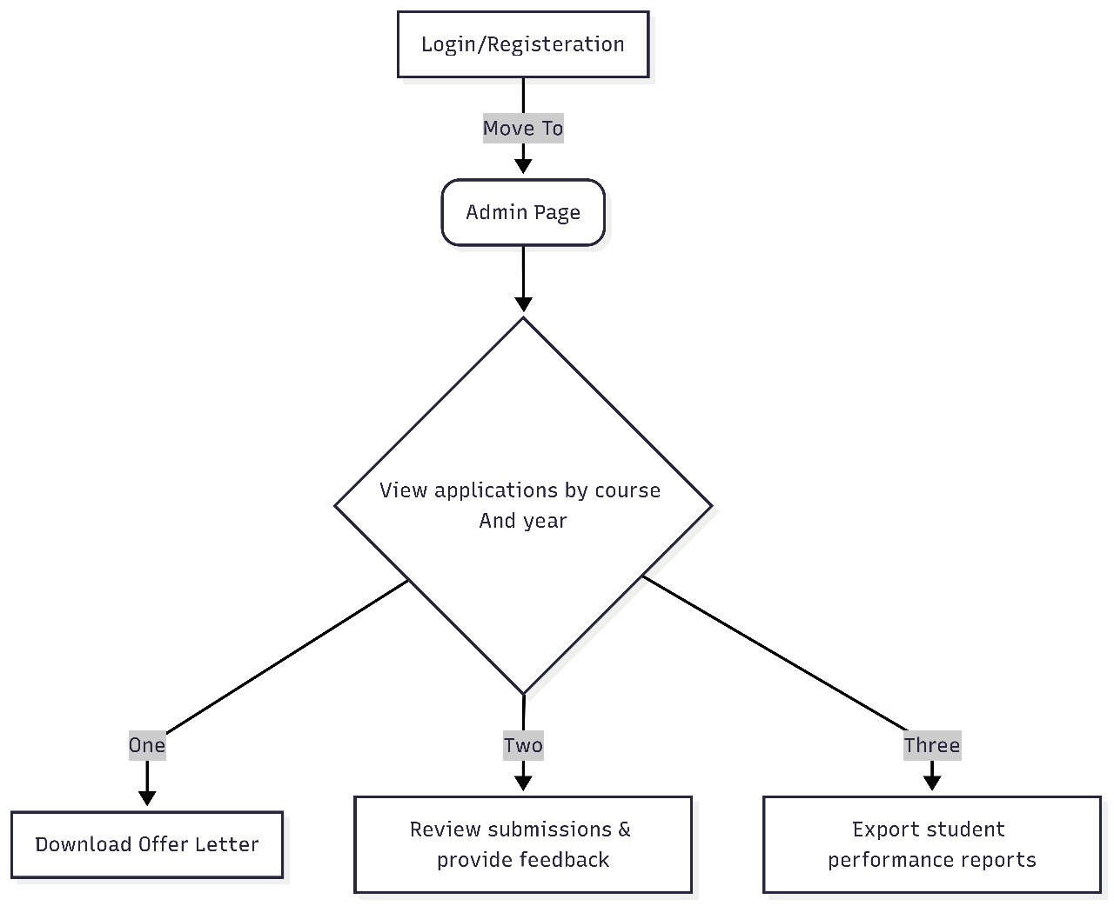
DATA FLOW DIAGRAM
INTERN
ADMIN

Slide 9




Technology Stack
MongoDB
Express.js
Database for users, tasks, applications, evaluations, and feedback.
Backend framework for building APIs and handling server requests.
React.js
Node.js
Frontend library for a fast, interactive, user-friendly interface.
Server-side JavaScript runtime for backend services.

Slide 10
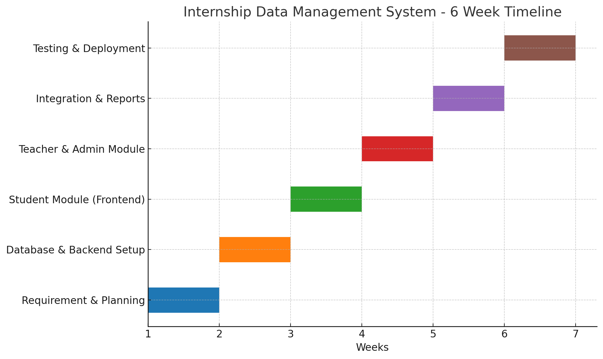
TIMELINE

Slide 11

Future Enhancements
1
AI Resume Screening
Faster shortlisting of interns.
2
Mobile Application
Easy access to tasks on the go.
3
Smart Matching
AI-based intern-mentor matching.
4
Stipend Management
Automatic payment tracking.
5
Chatbot Support
Instant answers and guidance.
6
LMS Integration
Link learning with internship tasks.

